Slide 1
Diabetes
Kellie Liu, Tony Tao, Elan Guo

Slide 2
Contents
Intro to Diabetes
Analyzing
Conclusion / Sum up

Slide 4
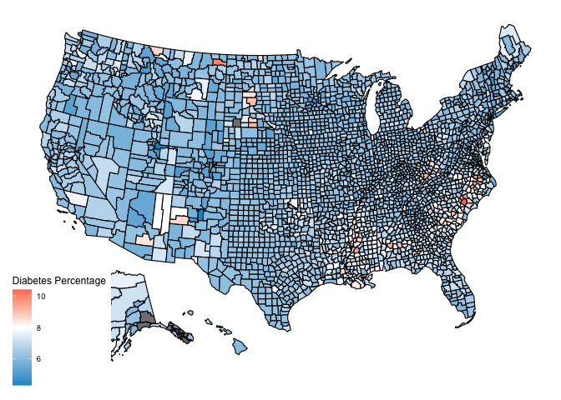
US Diabetes by County, 2004

Slide 5
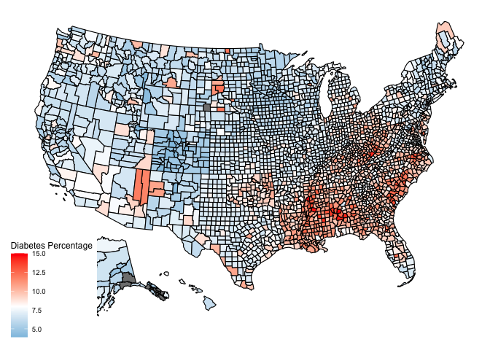
US Diabetes by County, 2008

Slide 6
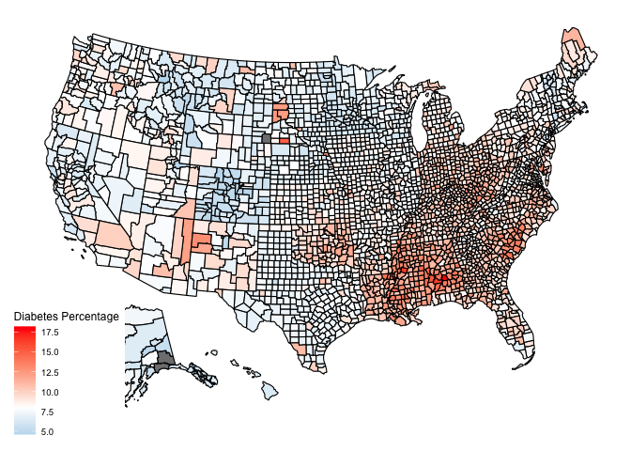
US Diabetes by County, 2012

Slide 7

US Diabetes by County, 2016

Slide 8
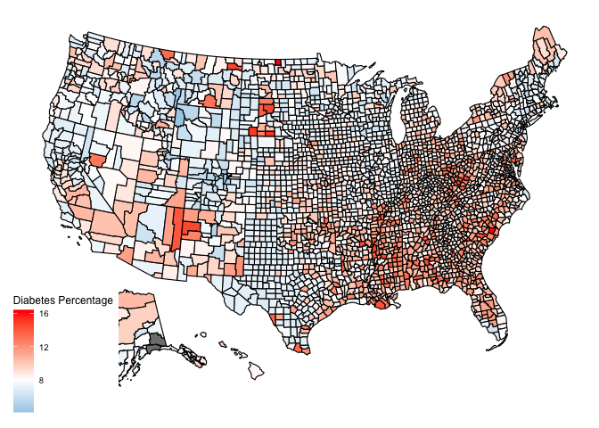
US Diabetes by County, 2020

Slide 9
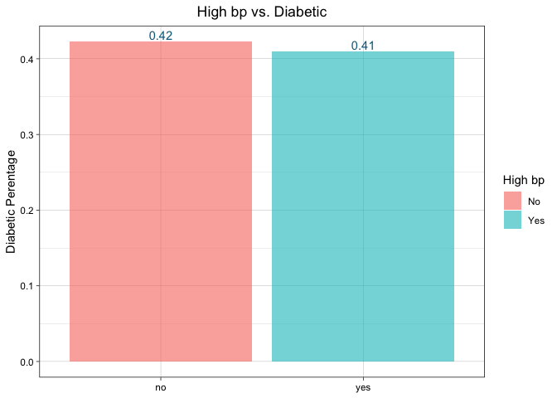
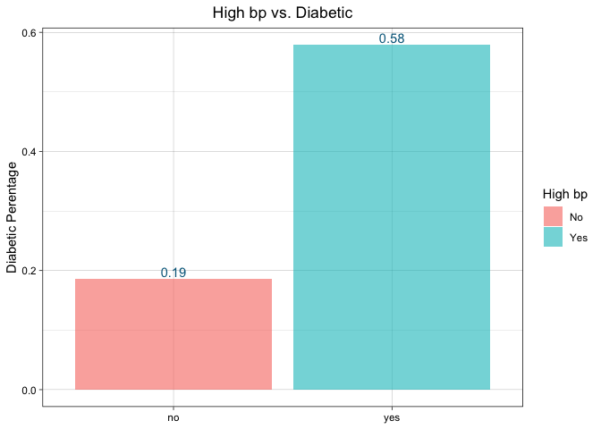
High Blood Pressure vs. Diabetes

Slide 10
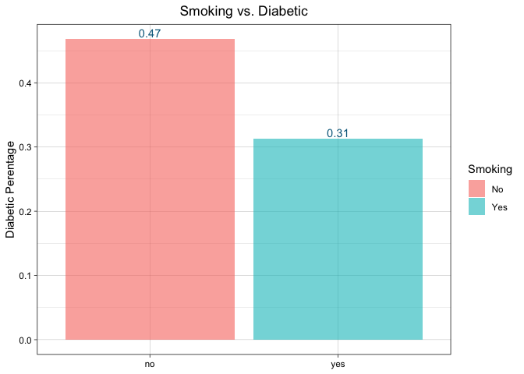
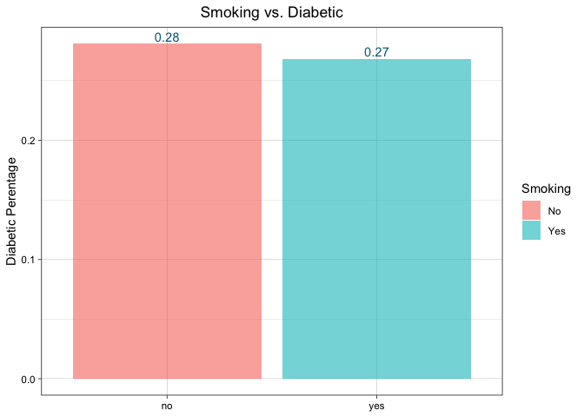
Smoking vs. Diabetes

Slide 11
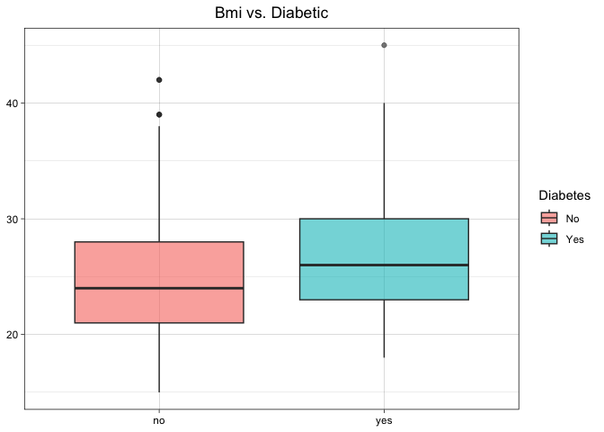
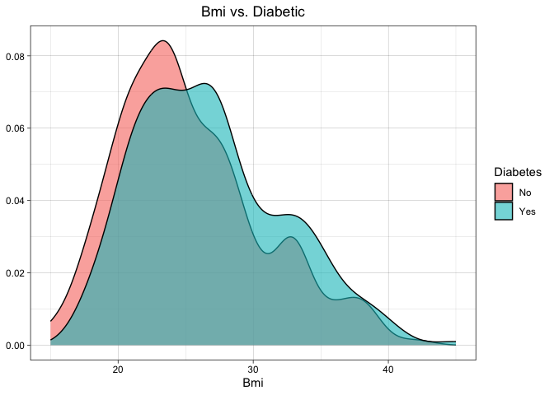
BMI VS. DIABETES

Slide 12
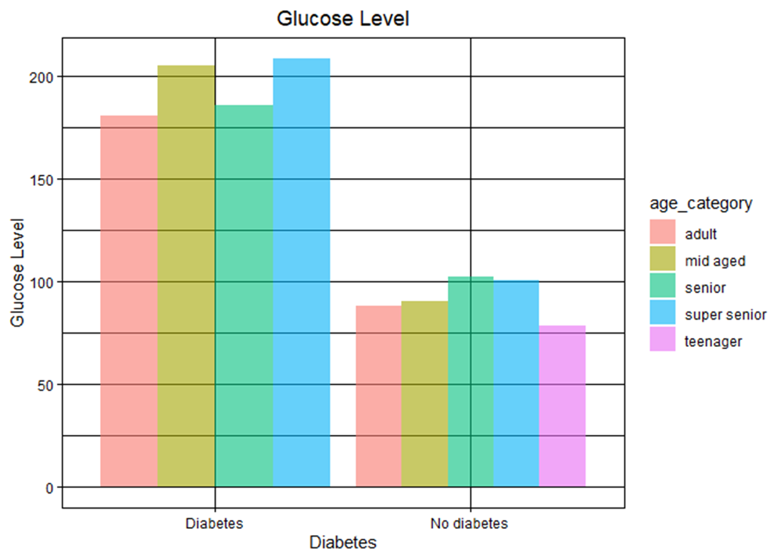
Glucose Level vs. Diabetes
Typically, fasting plasma glucose is below 100 mg/dl
Impaired: 100~125 mg/dl
Diabetic: >126 mg/dl

Slide 13
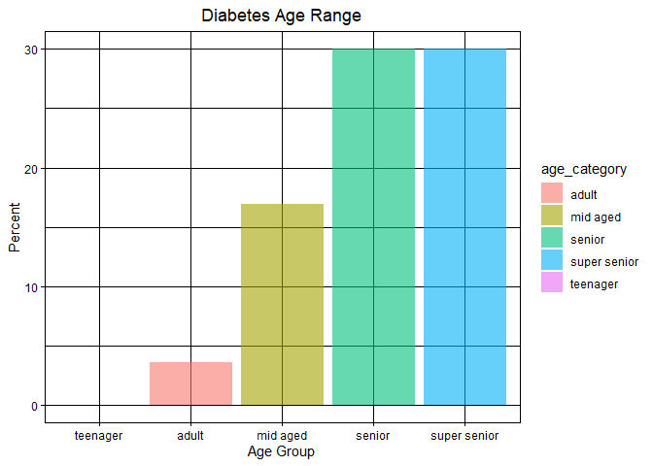
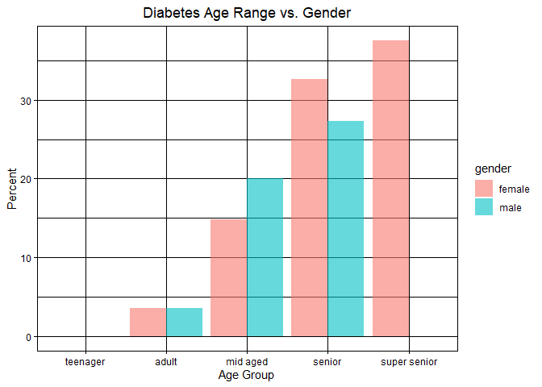
Age Range vs. Diabetes

Slide 14
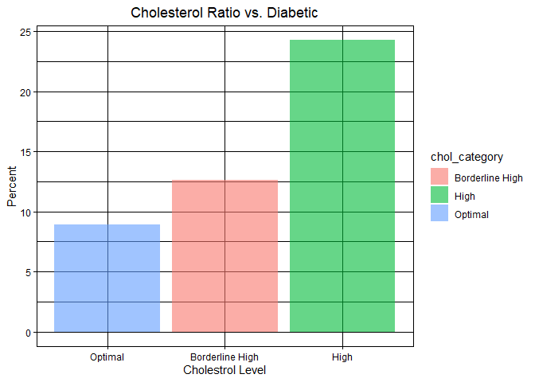
Cholesterol Level vs. diabetes
fdhfd

Slide 15
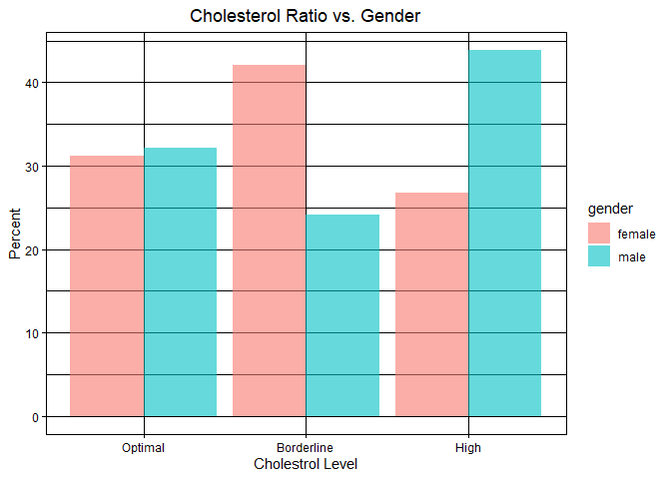
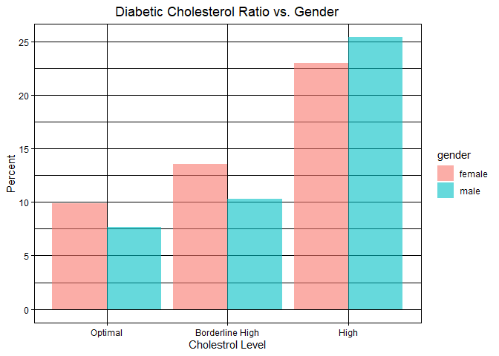
Cholesterol Level vs. diabetes

Slide 16
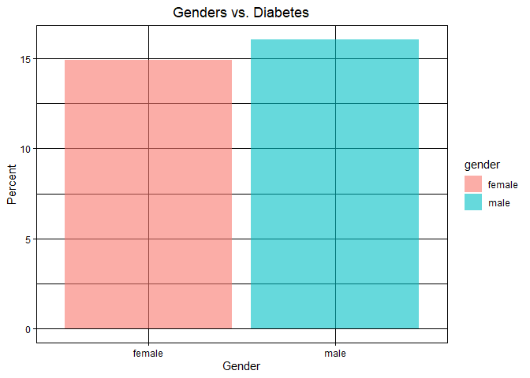
Gender Vs. Diabetes

Slide 17
Thank you

